Slide 1
SNS JU Phase 1 projects
Webinar #3 – Architecture & Secure Services and Security
Dr. Colin Willcock, Chairman of the Board 6G Smart Networks and Services Industry Association (6G-IA)
Dr. Odysseas Pyrovolakis, Programme Officer, Smart Networks and Services Joint Undertaking
Moderator: Uwe Herzog, Programme Manager, EURESCOM

Slide 2
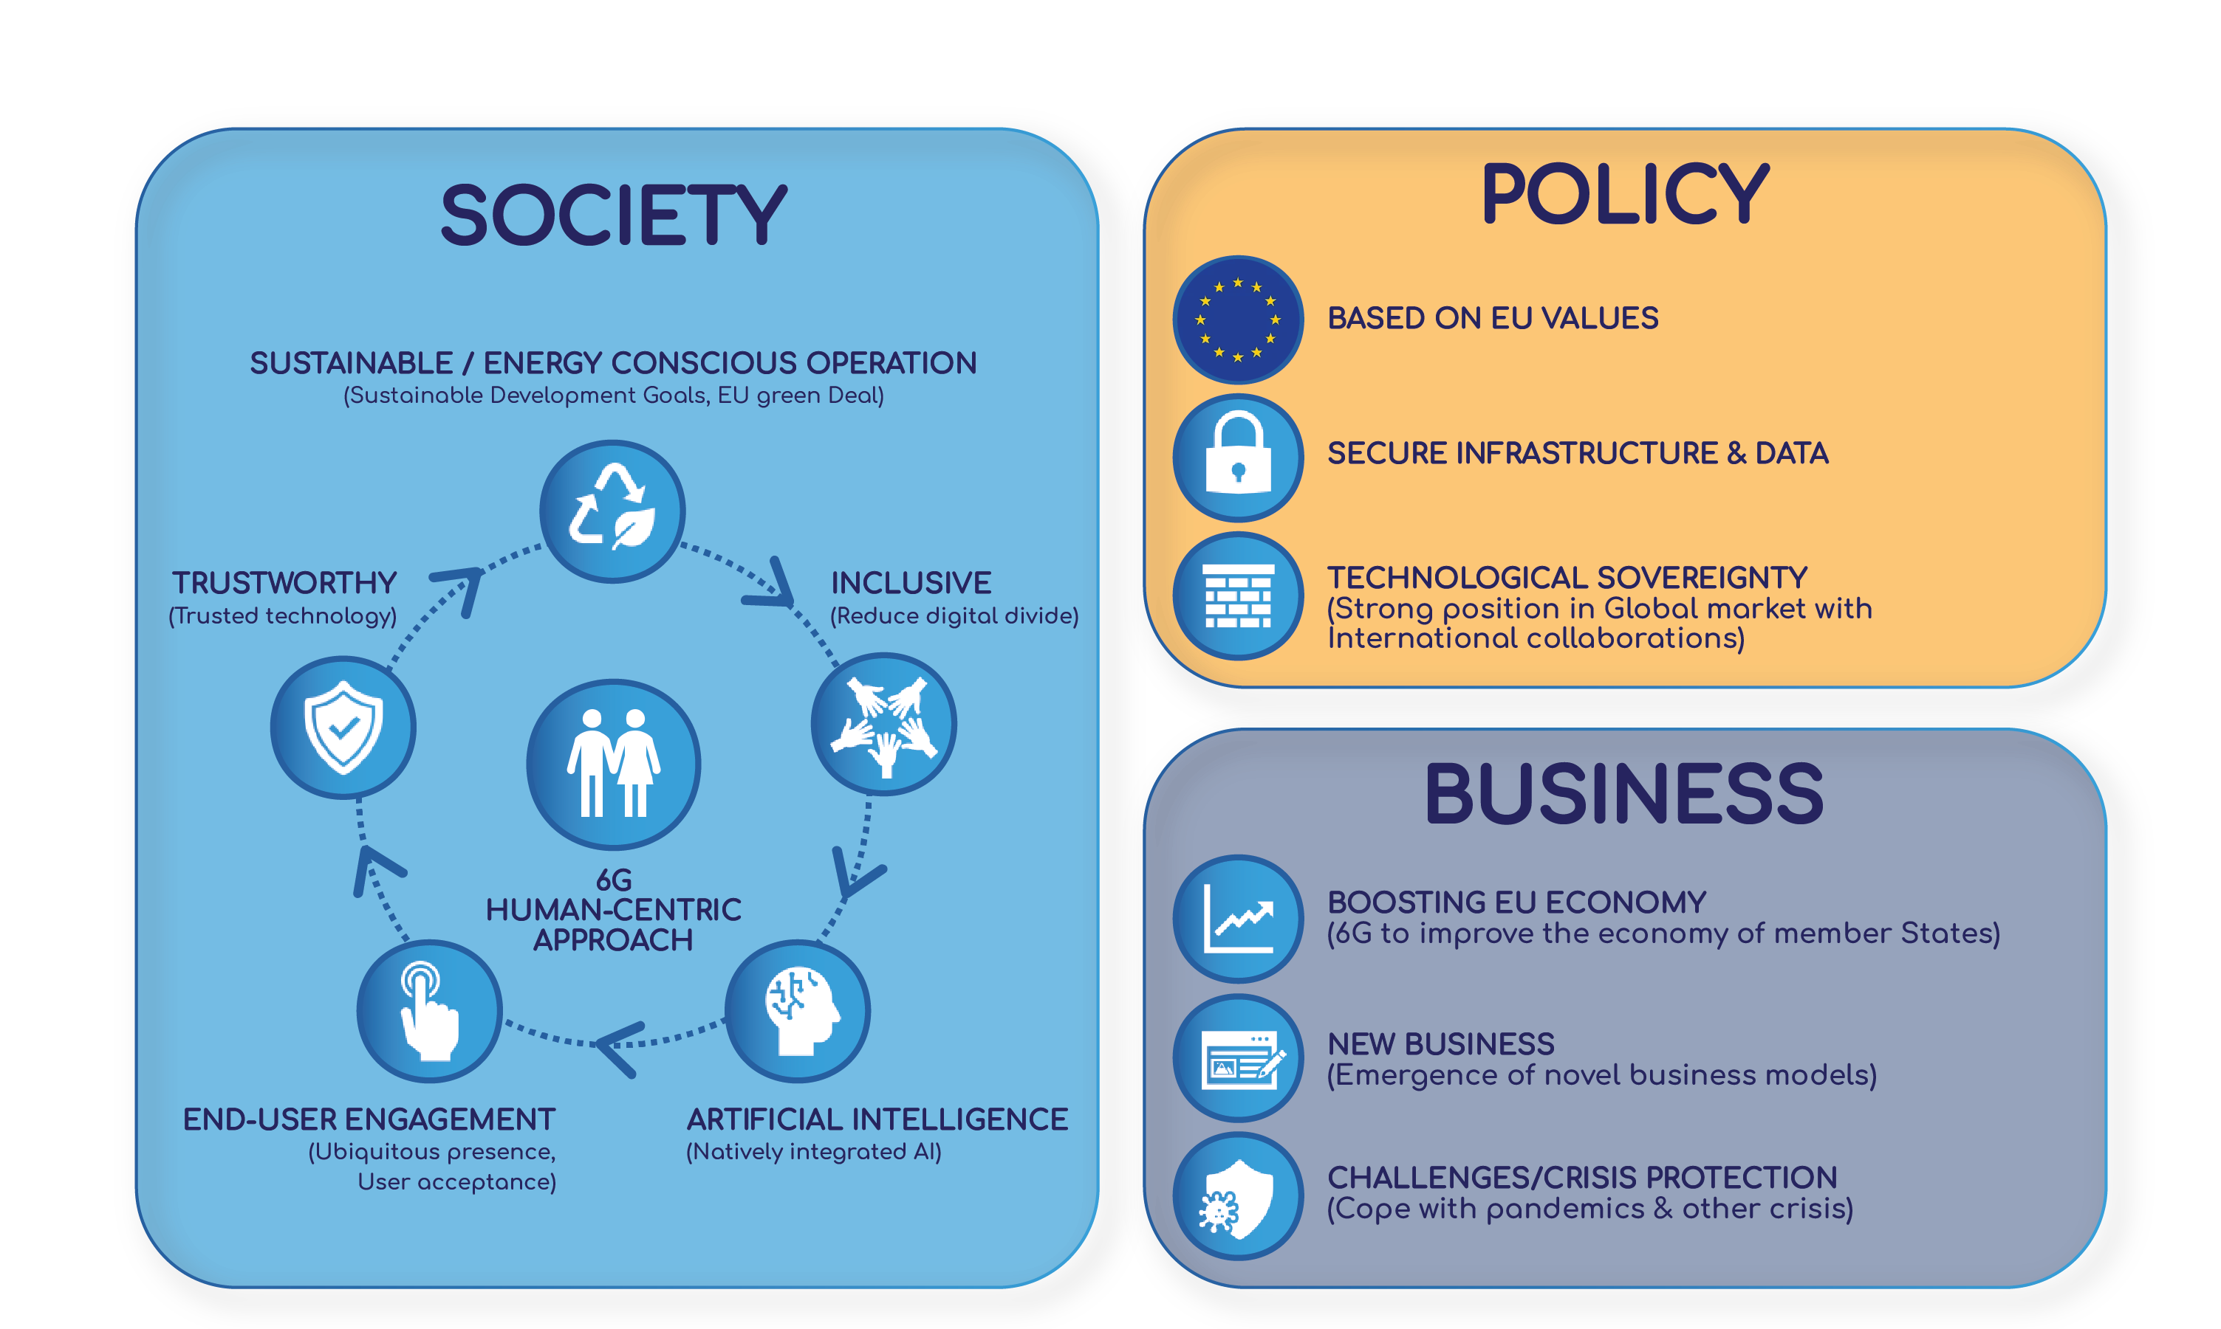


Societal, policy and business drivers for 6G
2

Slide 3









A JOINT UNDERTAKING FOR 6G NETWORKS AND SERVICES
To facilitate and develop industrial leadership in Europe for 5G and 6G networks and services by 2030
ENABLERS
• Flexible Architecture • Advanced Radio Access • Cloudfication • Native AI • Holistic Cybersecurity
DRIVERS
EU technological excellence
Competitive global business placement
Ensure Security and Privacy
Address Green Deal and SDGs
Need for globally accepted standards
EXPECTED RESULTS
Technological Leadership
EU industry competitive global value propositions
Meet demanding KPIs
Meet demanding KVIs
Sustainable and interoperable communication technologies
SMART SERVICES
Such as: advanced services for verticals, Metaverse, digital twin, holographic communications, etc.
INTERNATIONAL COLLABORATION
Media & Entertainment
Gaming & Metaverse
PPDR security- safety
Industry IoT
Energy
Automotive
Smart Cities
E-Health
Tourism &Culture
Smart Farming
EU R&I funding of € 900 million for the period 2021-2027, at least equally matched by private side resources
3

Slide 4
WGs and Collaboration during the SNS era
The SNS Collaboration agreement is ready. The signing process has started in the following order
  6G-IA Board members – ongoing
  SNS JU projects – not started yet
  6G-IA members – not started yet
A plan is being prepared – SNS WGs will be discussed/decided involving the Projects
Three types of WGs are envisioned
  SNS Projects WGs (similar to the 5G PPP WGs)
  6G-IA WGs
  SNS Strategic WGs (To be created by the SNS GB)
A webinar will take place (May 2023) to present the plan and open a consultation
Target to present the final structure at EuCNC 2023
Guarantee continuity from the 5G PPP era
Next steps:
  Until the collaboration agreement is signed by a critical mass of projects/project members an unofficial pre-SB will be setup to start the coordination among projects
  When a 70% of projects will have signed the CA, an election process will open to select the Chairs for the SB/TB
  After the SB is officially formed, the formal decisions for the SNS Project WGs will be taken

Slide 5

Beyond 5G/6G Timeline
2019
2020
2021
2022
2023
2024
2025
2026
2027
2028
2029
2030
Initial 5G
SNS Phase 1
SNS Phase 2
SNS Phase 3
Evolutionary 5G, 6G exploration, concepts, definitions
6G detailed design, system optimisation
Pre-commercial 6G systems
WRC19
WRC23
WRC27
6G System Projects
6G Requirements Convergence
Early 6G Trials
6G Specifications
IMT-2030 tech
IMT-2030 Req.
Initial 6G
IMT-2030 Vision
IMT-2030 Rec.
R16
R17
R18
R19
R20
R21
R22
R23
B5G Study and Specification
6G Study and Specification
5

Slide 6

Your projects in SNS R&I Work Programme 2021-22
Evolution
Stream A (RIA): Smart communication components, systems and networks for 5G mid-term Evolution systems
Stream B (RIA): Research for Revolutionary 6G Technology and systems
Radio:
Building Blocks and Systems
System Architecture
Wireless Communication Technology and Signal Processing
Architecture:
Evolved Design
Advanced Cloud/Edge Converged Optical Transport
System and Security:
Secure Softwarisation
Real-time/ Zero touch Services
Holistic System Perspective
Trustworthy and Secure Service Development and Provision
Communication Infrastructure Technologies
Stream D (IA): Large Scale SNS Trials and Pilots with Verticals
Stream C (RIA): SNS experimental infrastructures
See Results: Europe scales up 6G research investments and selects 35 new projects worth €250 million
6

Slide 7
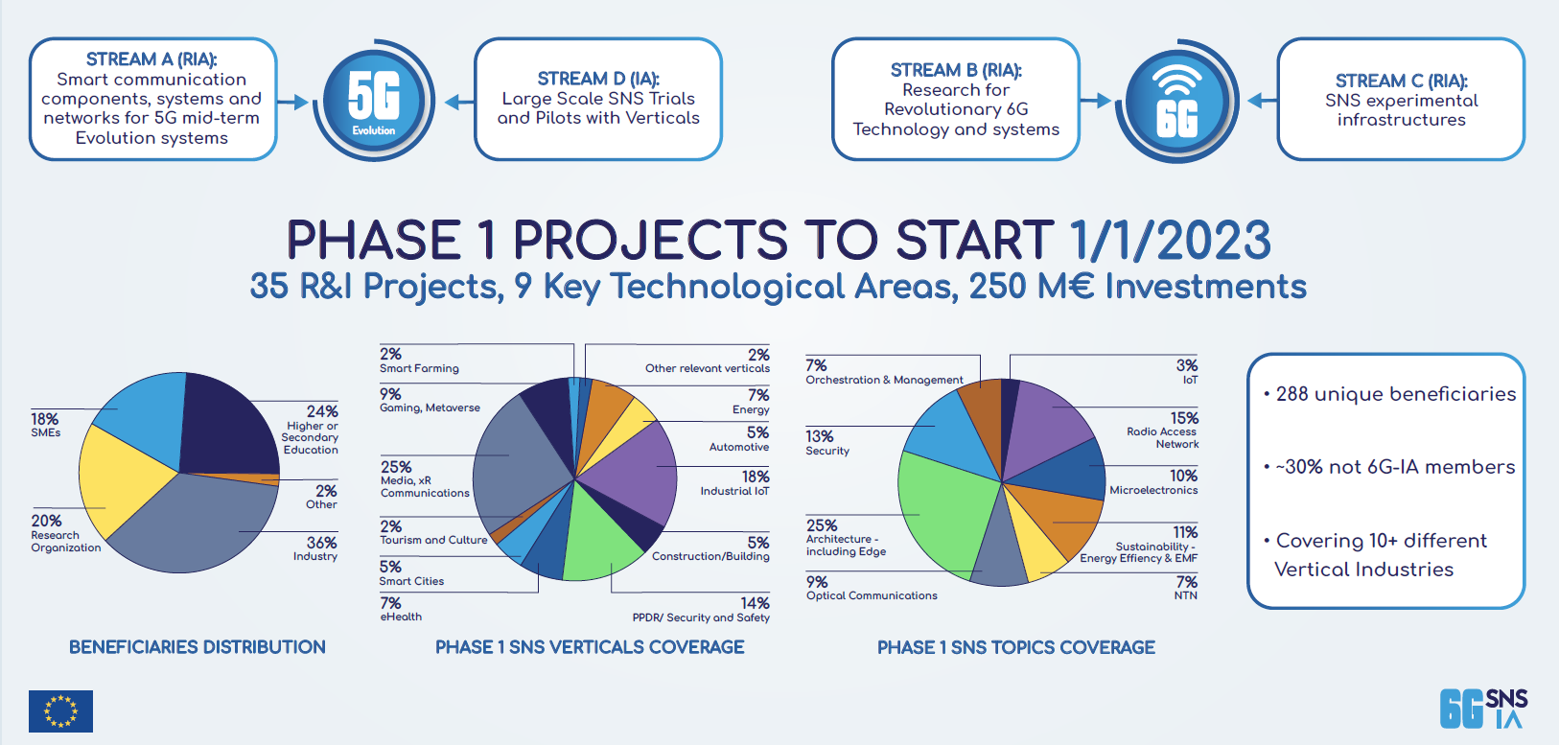
SNS JU First Call 2022: Funding and results
7

Slide 8
Strand B 1 – System Architecture highlights
System Architectures for intelligent connectivity and service provision across a huge number of heterogeneous domains, resources and unlimited application reqs
  Catering extreme 6G use cases.
  Serving different infrastructures, businesses and application environments, capable for unified service provision.
  Offering inter-computing sustainable solutions beyond the inter-networking capabilities of the Internet.
  Promoting programmable architectures and technologies.
Focus on :
  Scaling Inter-computing systems.
  Frictionless inter-domain resource management.
  Native AI for telecommunications.
  New data transfer paradigms with deep edge integration.
  Deterministic Networking.
8

Slide 9
Strand 4 - Secure Service development & Smart Security highlights
Reliable, trusted and resilient critical infrastructures, like 6G, based on heterogeneous environments of converged networks and IT systems enabling future digital services.
  Technologies supporting trustworthiness, resilience, openness, transparency, and dependability expected under the EU regulations (GDPR, CSA etc.), in the context of programmable platforms, considering vertical industries as users.
  Open-source solutions in the context of multi-vendor interoperability.
  Secure, host-neutral infrastructures.
  Secure & trustworthy smart services lifecycle management
  AI technologies for secure 6G – Secure AI
Focus on :
  Human Centric methods for privacy and confidentiality.
  Holistic Smart Service frameworks.
  Secure Lifecycle management.
  Security enablers for untrusted environments (Security techniques using AI, rule-based/ statistical/contextual analysis and DLTs).
9

Slide 10
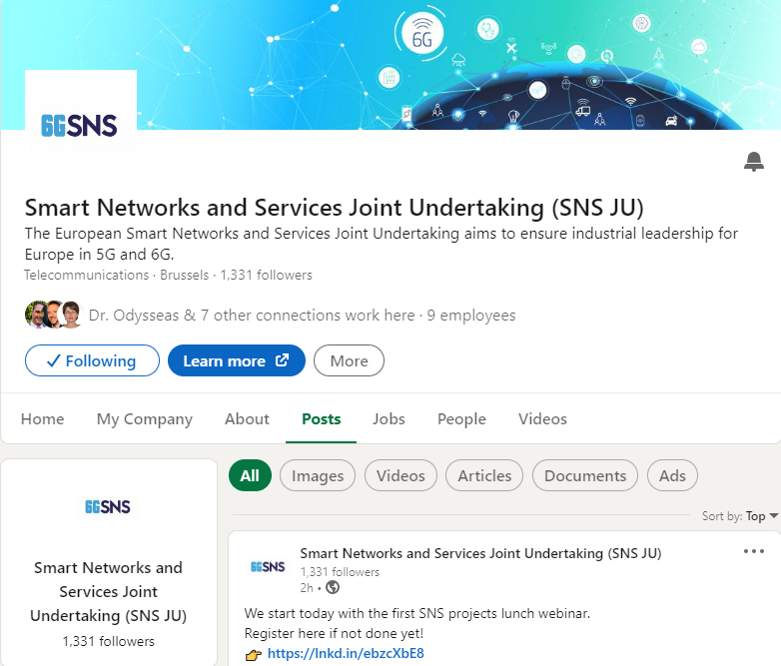
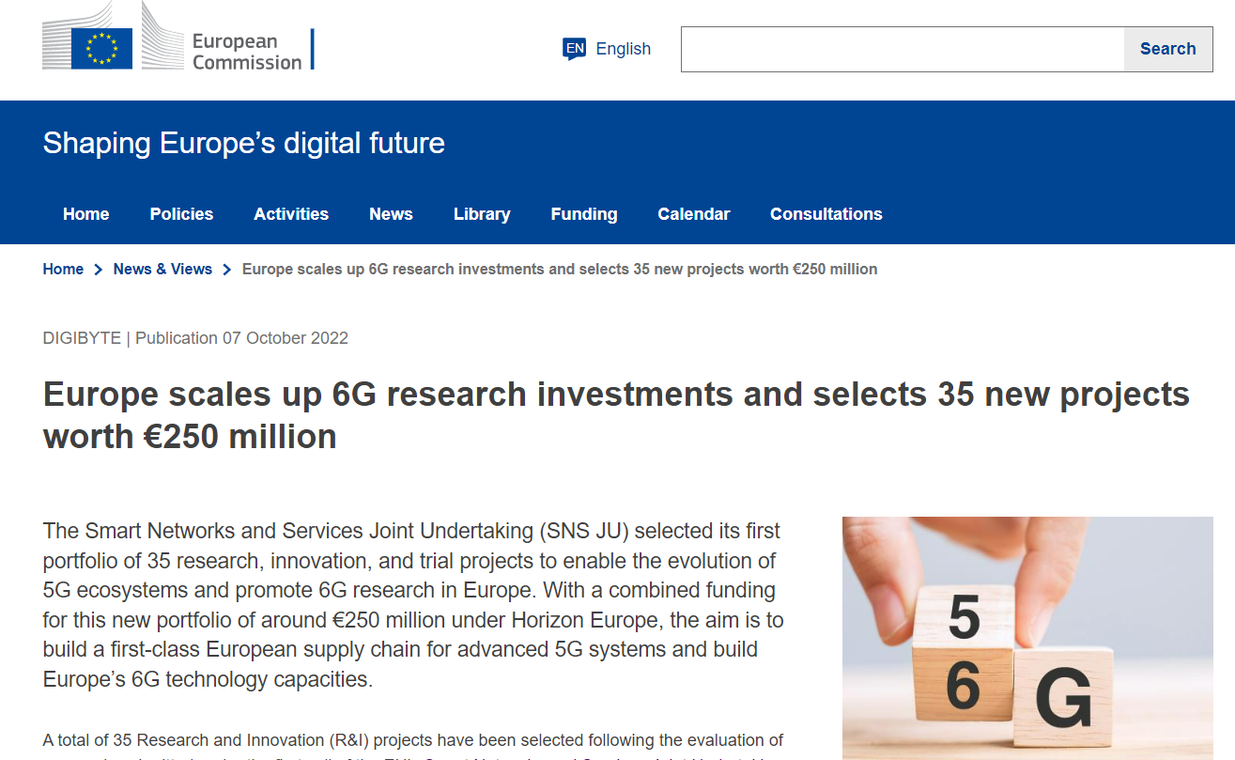
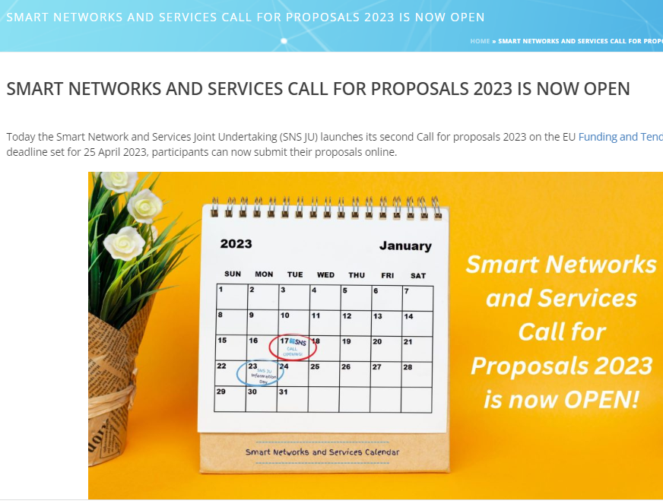
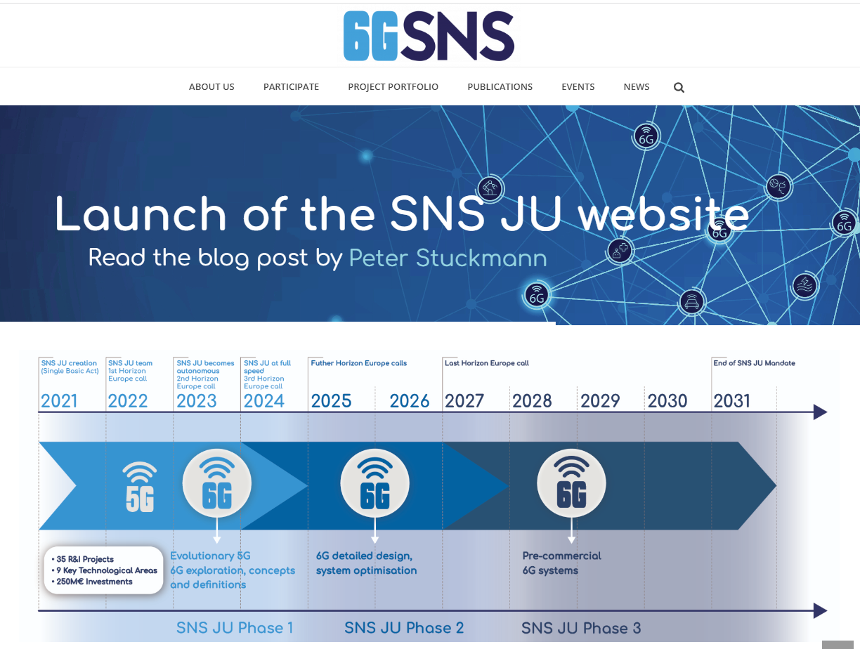
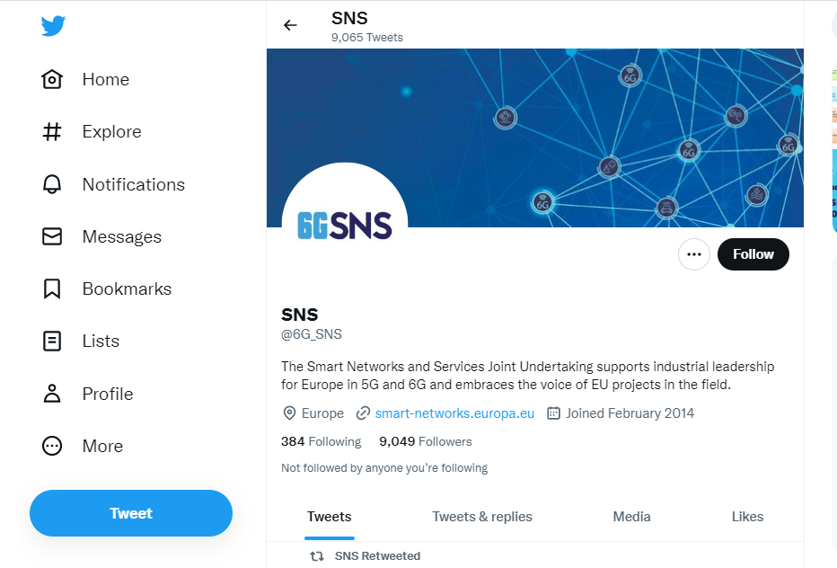
Projects are instrumental to SNS communication!
NEW
SNS brand and Projects communication guidelines… (to come)
Press releases
YouTube
LinkedIn
Website
https://smart-networks.europa.eu/
Twitter
10

Slide 11


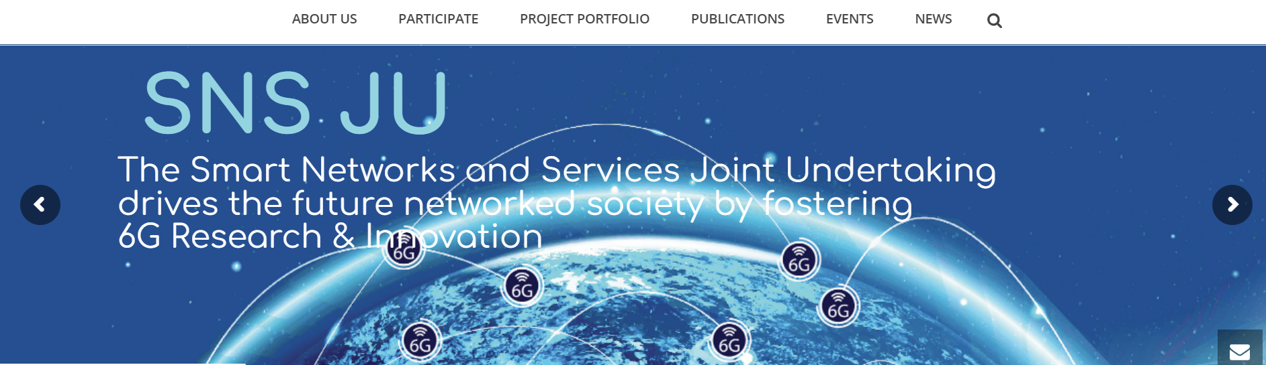

Thank you!
Visit SNS JU website: https://smart-networks.europa.eu/
@6G_SNS
11

