Slide 1



INTRODUCING THE SNS PROJECTS
Webinar 3 – Stream B1 and B4 Projects
Architecture & Secure Services and Security
Webinar
23/02/23

Slide 2
The webinar will start at 12:00 CET
Please use the Chat box for your questions
The Webinar will be recorded.
All slides and the recording will become available after the Webinar.
Presenters, please email your slides to web-support@sns-ju.eu

Slide 3
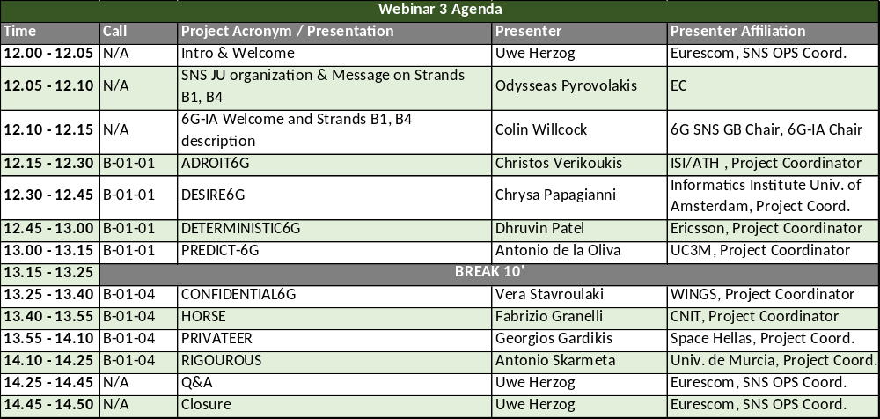
Agenda

Slide 4
Short Break
The webinar will resume at 13:25 CET

Slide 5
Q&A
from Bernard Barani: 1:51 PM
@ Horse (Fabrizio Granelli). Your end to end scenarios includes resources that may be implemented across multiple domains, e.g. through an hyperscaler. How can you ensure knowledge of such third party resources? i.e. how can you ensure access to resources provided across multiple heterogeneous domains, not one single uniform CSP domain?

Slide 6
Next Webinar
Webinar 4 – Strand B2 & B3 Projects
Wireless Communications and Signal Processing & Communication Infrastructure and Devices
Monday 6th of March, 12.00 CET

